Slide 1
Program Design ITPRA0

Slide 2
Disclaimer
Please note that content made available on myLMS may deviate only slightly from what is covered in lecturer-led sessions, however, the content uploaded to myLMS represents all the material that you need to refer to in preparation for your assessments.

Slide 3
Eduvos and the Flipped Classroom
1
2
3
Before this lecturer-led session
During this lecturer-led session
After this lecturer-led session
At home, in your self-study time, you worked through myLMS content to prepare you for this lecturer-led session. You have completed any practice activities and prepared any questions you may still have on the content. The lecturer-led session will not be a traditional lecture.
During your lecturer-led session(s), you will engage with your peers and lecturer in active learning. I.e. you will have an opportunity to ask your questions, to debate topics, and to practice working through the technical aspects of what you learnt at home. You will be exposed to higher-order thinking activities. Your lecturer will guide you on what to prepare before attending your next session.
Depending on how difficult this lecturer-led session is, your lecturer may recommend some concepts to revise for this week's learning opportunities. Then you will focus on the following learning opportunities on myLMS in your self-study time to prepare for the next lecturer-led session(s).
3

Slide 4
What will be covered in the rest of today’s session?
What will be covered in the lecture-led session:
Explain what a module is
Import and use the turtle module
Create Turtle objects
Draw basic shapes using turtle graphics
Apply loops with turtle graphics
Understand basic object-oriented programming concepts

Slide 5
What is a Module?
A module is a file containing Python code.
Modules allow programmers to reuse code written by others.
Python includes many built-in modules.
Examples:
math
random
turtle
Python makes code sharing easy through modules.

Slide 6
What is Turtle Graphics
Turtle graphics allows programmers to draw shapes on the screen.
A turtle moves around like a pen.
When the pen is down → it draws.
When the pen is up → it moves without drawing.
Uses:
Learning programming
Understanding OOP
Creating graphics

Slide 7
Importing Modules
Method 1: Safe import
Method 2: Import Everything
import turtle
To use Turtle:
t = turtle.Turtle()
Advantages:
Safe
Prevents naming conflicts
from turtle import *
Now you can write:
t = Turtle()
Advantages:
Shorter code
Disadvantages:
Can overwrite names in your program

Slide 8
Creating a turtle object
How to create a turtle object
Explanation
import turtle
t = turtle.Turtle()
t is a variable
It stores a reference to a Turtle object
Objects can perform actions using methods
Example methods:
forward()
left()
right()

Slide 9
Drawing a square
Loop repeats 4 times
Turtle moves forward
Turns 90 degrees each time
import turtle
t = turtle.Turtle()
for i in range(4):
t.forward(100)
t.left(90)
screen = turtle.Screen()
screen.exitonclick()

Slide 10
Turtle Methods
Method | Purpose
forward(x) | Moves turtle forward
backward(x) | Moves turtle backward
left(angle) | Turns left
right(angle) | Turns right
penup() | Stops drawing
pendown() | Starts drawing

Slide 11
Using Loops with Turtle
Loops help reduce repeated code.
Without loops:
t.forward(50) t.left(90)
t.forward(50) t.left(90)
t.forward(50) t.left(90)
t.forward(50) t.left(90)
With loops:
for i in range(4): t.forward(50) t.left(90)
Benefits:
Cleaner code
Easier to maintain

Slide 12
Drawing a Pentagon
from turtle import *
t = Turtle()
for i in range(5):
t.forward(100)
t.left(72)
done()
Why 72°? → 360÷5=72

Slide 13
User Input Example
import turtle
sides = int(input("Enter number of sides: "))
t = turtle.Turtle()
angle = 360 / sides
for i in range(sides):
t.forward(80)
t.left(angle)
screen = turtle.Screen()
screen.exitonclick()
This program:
Accepts user input
Draws a regular polygon

Slide 14
Common Mistake
Do NOT name your file turtle.py
Why?
Python may import your file instead of the real turtle module.
Solution:
Use another filename such as:
shapes.py
graphics.py

Slide 15
Enhancing Turtle graphics
Turtle can also:
Change colours
Change pen size
Draw circles
Fill shapes
Write text
Example:
t.color("blue") t.circle(50)

Slide 16
Activity
Write a Python program that:
Draws a triangle
Uses a loop
Changes the turtle colour
Uses exitonclick()

Slide 17
Creating objects in Python
To create an object of a certain type or class, we write:
objectref = Class()
Example:
t = Turtle()
This:
Creates a Turtle object
Stores the object in memory
Makes variable t refer to the object

Slide 18
What happens when an object is created
When Python creates an object:
Memory is reserved for the object
The object is initialized
The variable points to the object
A Turtle object stores information such as:
Position on screen
Direction
Colour
Pen status
This process is called object construction.

Slide 19
Constructors in Python
A constructor is used to create objects.
General syntax:
ClassName(arguments)
Example:
t = Turtle()
The constructor:
Creates the object
Initializes its data
Returns the object

Slide 20
Examples of constructors
name = str("John")
age = int("25")
price = float("19.99")
number = float(7)
mylist = list()
Each class has its own constructor.

Slide 21
Constructors with Different Arguments
x = float("5.6")
y = float(8)
Both create float objects.
Results:
x → 5.6
y → 8.0

Slide 22
Constructors with Different Arguments
When we write:
t = Turtle()
Python:
Calls the Turtle constructor
Creates a Turtle object
Makes t point to the object
This object is called an instance of the class.

Slide 23
Accessor Methods
An accessor method is used to get information about the state of an object.
Accessor methods:
Return information
Do NOT change the object
General syntax:
object.method()

Slide 24
Example of Accessor Method
import turtle
t = turtle.Turtle()
print(t.heading())
Explanation:
heading() returns the turtle’s current direction
The turtle itself does not change
Accessor methods only access data.

Slide 25
Accessor methods and Object State
A Turtle object stores information such as:
Position
Heading (direction)
Colour
Pen status
Accessor methods allow us to inspect this information safely.
Method | Purpose
heading() | Returns direction
position() | Returns current position
xcor() | Returns x-coordinate
ycor() | Returns y-coordinate

Slide 26
Mutator Methods
A mutator method changes the state of an object.
Mutator methods:
Modify the object
Usually require information from the programmer

Slide 27
Examples of Mutator Methods
These methods change:
Position
Direction
Colour
Mutator methods mutate the object.
t.forward(100)
t.left(90)
t.color("blue")

Slide 28
Accessor vs Mutator Methods
Accessor Methods | Mutator Methods
Return information | Change object state
Do not modify object | Modify object
Example: heading() | Example: forward()

Slide 29
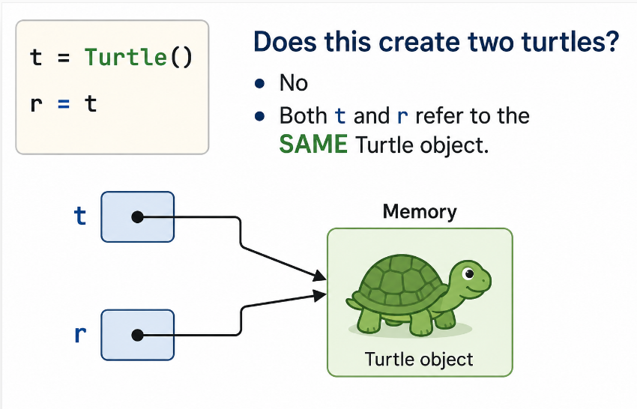
References and Objects
Consider this code:
t = Turtle() r = t
Does this create two turtles?
No
Both t and r refer to the SAME Turtle object.

Slide 30
One Object Two references
from turtle import *
t = Turtle()
r = t
t.forward(100)
r.left(90)
r.forward(50)
t and r point to the same turtle
Changes made using one reference affect the same object
Assignment does not copy objects
r = t
This:
Copies the reference
Does NOT create a new object
Both variables point to the same memory location.

Slide 31
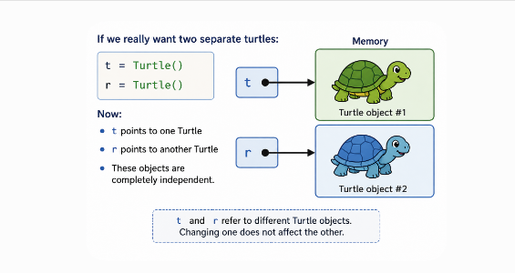
Creating a Second Object
If we really want two separate turtles:
t = Turtle() r = Turtle()
Now:
t points to one Turtle
r points to another Turtle
These objects are completely independent.

Slide 32
Immutable Classes
An immutable class is a class whose objects cannot be changed after they are created.
Immutable objects:
Have no mutator methods
Cannot be modified after creation
Examples of immutable types in Python:
int
float
str
bool
Because these objects cannot change, it does not really matter whether two references point to the same object or different objects.

Slide 33
Immutable Objects and References
What happens?
Example
The original string "John" does NOT change
A NEW string "John Smith" is created
The variable name now points to the new object
Important Idea:
String objects never change once created
References can change to point to new objects
Immutable objects are easier to work with because programmers do not have to worry about accidentally changing them.
name = "John"
name = name + " Smith"

Slide 34
Activity
Study the code below and answer the questions
Questions
word1 = "Python"
word2 = word1
word1 = word1 + " Programming"
print(word1)
print(word2)
What is the value of word1?
What is the value of word2?
Did the original string object change?
Why is the str class called immutable?

